Slide 1




Temperature Variation Aware Energy Optimization in Heterogeneous MPSoCs
Mohammadsadegh Sadri
Department of Electrical, Electronic and Information Engineering (DEI) University of Bologna, Italy
Supervisor : Prof. Luca Benini
{mohammadsadegh.sadr2,luca.benini}@unibo.it
Ver4 - last update 30-jan-2014
Notes:
1
1

Slide 2
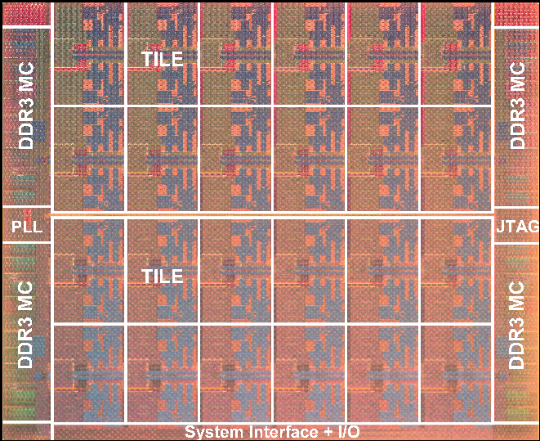
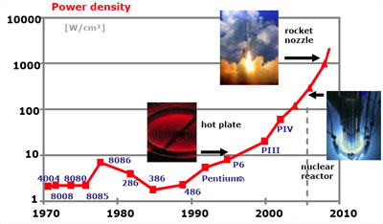
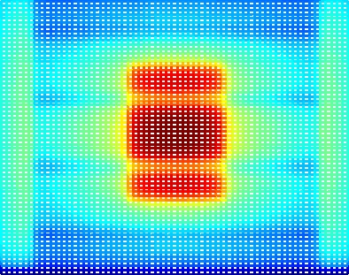
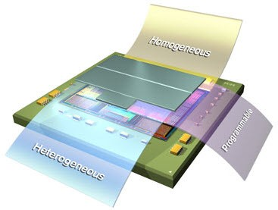
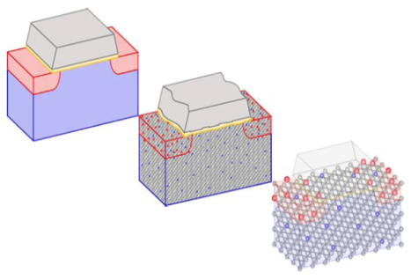
Introduction
MPSoCs, Many-cores,
3D Integrated circuits ……
Increasing power density!
Hotspots!
Magnificent Spatial and Temporal Temperature Changes (Variations).
  Results :
  System Operation Failure!
  Accelerated aging!
  Energy and Design inefficiency!
  …
CMOS
65nm
CMOS
40nm
CMOS
28nm

Slide 3
Outline
Introduction
MiMAPT : Temperature Variation Aware Design Analysis
Energy Optimization in 3D MPSoC with Wide-IO DRAM
A Heterogeneous Many-core Architecture using ZYNQ
Conclusion & Future works

Slide 4
Part II
MiMAPT : Temperature Variation Aware
Delay, Power and Thermal Analysis

Slide 5
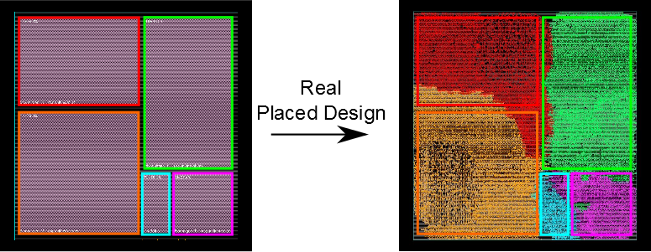
Necessity of Fast & Accurate Thermal Analysis
Need for a Short-cut!
  Early detection of suspicious cases
  Trigger Fine-grain only when needed!
High Power
Densities
Temporal Variability of workload
Non-regular layouts for RTL entities
High spatial resolution for thermal simulation
Transient thermal simulation over long intervals
Build a versatile method to define thermal floorplan
For nowadays designs:
Very time consuming!
Practically Impossible!
Thermal floorplan, different than layout floorplan!

Slide 6
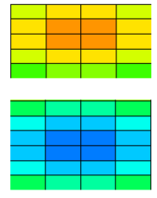
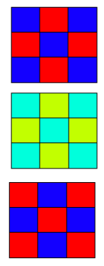
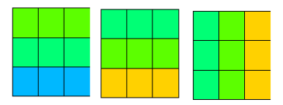
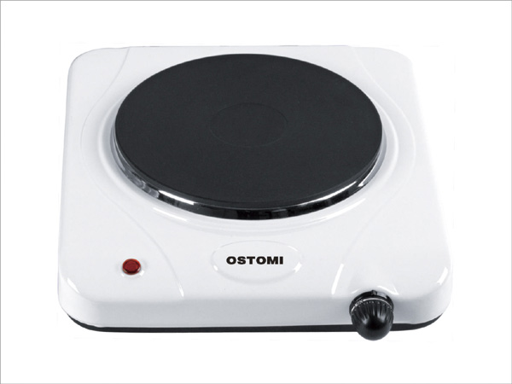

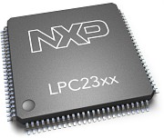

Temperature Distribution
Non-Uniform
Bell Shapes
Other Cases
Horizontal or Vertical Gradients
Conclusion:
Delay/Power Analysis May Need to be Done:
  For Every Possible Design Operating Condition.
  (Not only characterized corners.)
  Considering Non-uniform die Temperature.
  You need a tool:
    To Arm the Timing/Power Analysis tool
    (e.g. Synopsys Prime-Time)
    To Account for Non-uniform Temperature
    Of Standard-cells in Delay/Power Analysis
110C
…
Self Heating
…
25C
25C
25C
25C

Slide 7
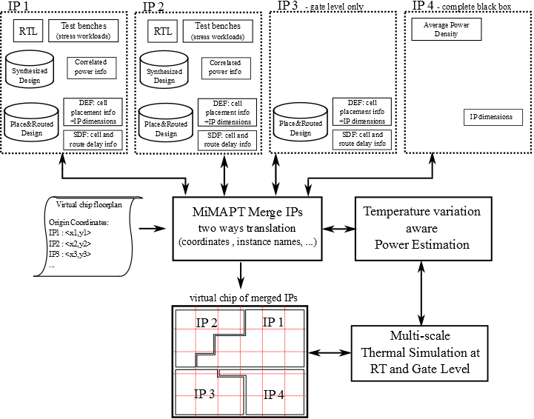


MiMAPT
Micrel’s Multi-scale Analyzer for Power and Temperature
Cadence Flow:
  RTL Compiler (RC) (v.10.1)
  SoC Encounter (v.10.1)
Synopsys Flow:
  Design Compiler (v2010.03)
  ICC Compiler (v2010.03)
  PrimeTime (v2010.06)
1
MiMAPT Understands:
Standard design flow file formats:
  .LIB, .LEF : Std-cell Lib.
  .DEF, .TCL: physical info
  ...
Tool report formats:
  Synthesizer power report
  Timing/Power analysis tool power/delay reports
5
2
4
3
Fast & Accurate
Detection of Hotspots
(Spatial and Temporal coordinates)
MiMAPT Performs delay/power and thermal analysis considering temperature non-uniformities
MiMAPT is not limited to a specific thermal simulation engine
(currently uses Hotspot)
Acceleration:
Do thermal simulation at RT Level
Switch to Gate Level when necessary
MiMAPT integrates into Standard ASIC design flow
Merged Virtual Chip Analysis:
Even if final chip is not ready, you can obtain thermal estimates.

Slide 8
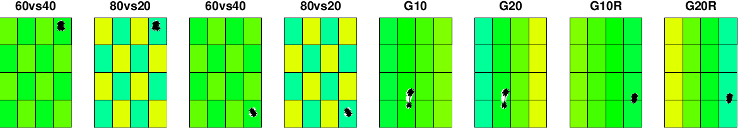
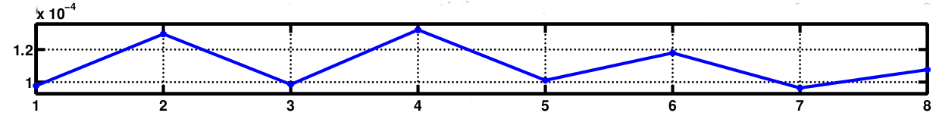
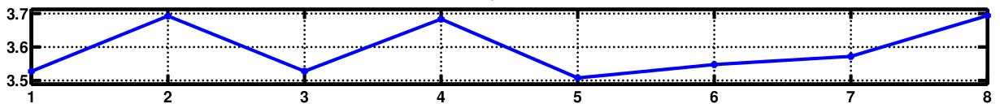
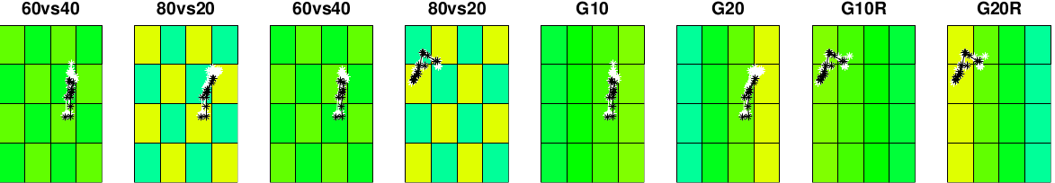
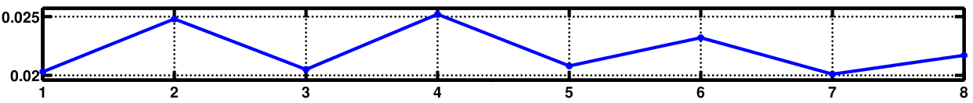
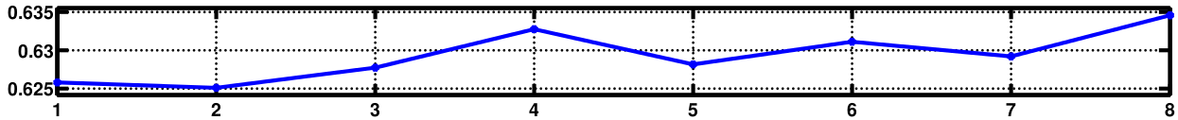
Non-uniform Temperature Map
Critical
Timing Path
Dynamic Power
Static Power
Total Power
Critical
Timing Path
Static Power
Period
Period
Value at uniform 50C
40nmLP – VDD=0.81v (X : pattern number)
17MHz (Real running frequency: 271MHz, estimated one: 288MHz
40nmLP – VDD=1.21v (X : pattern number)
5.4mW → Example chip: Intel SCC: ~3 Watts difference in real static power and estimated one

Slide 9
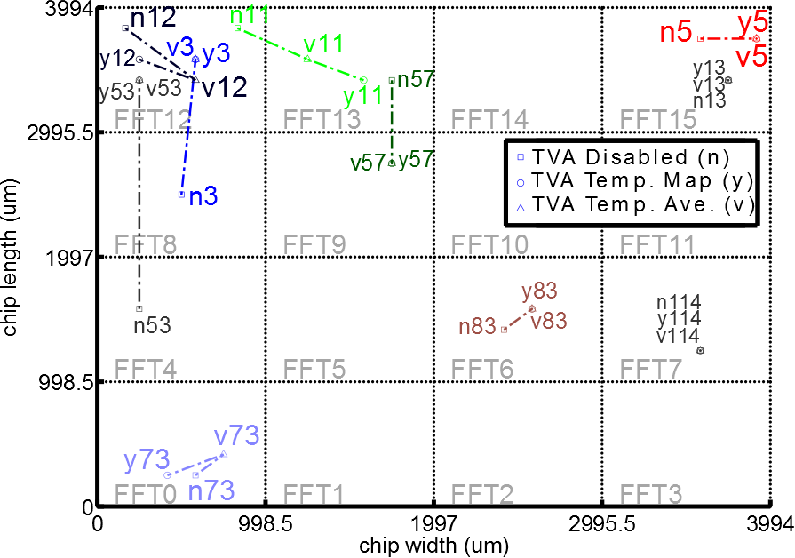
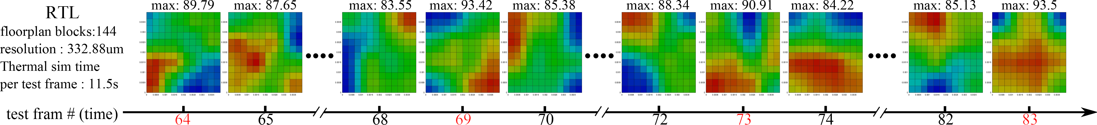
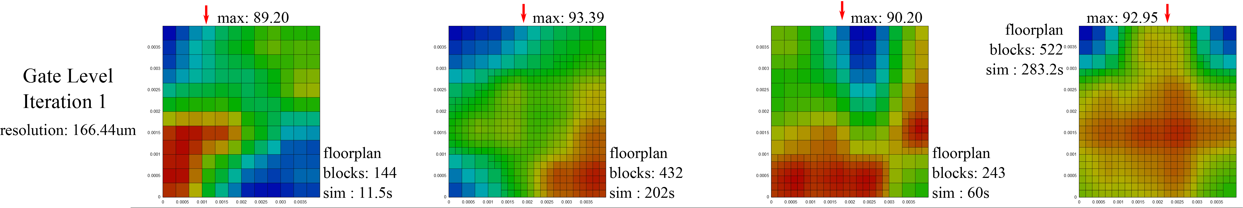
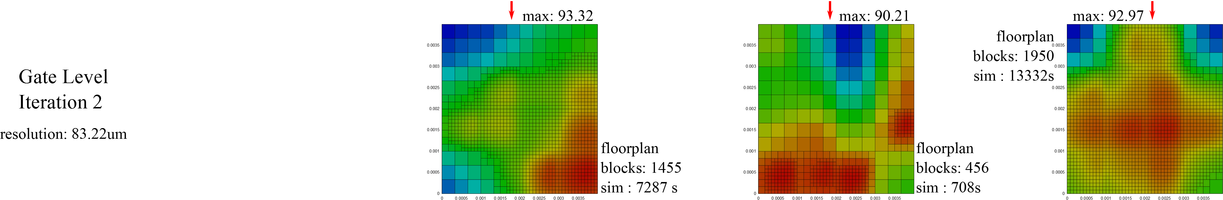
Example MiMAPT Operation

Slide 10
MiMAPT vs. Fine-Grain
Design
&
Test case
Temperature difference for Hotspots estimated by MiMAPT vs. fine grain: 0.02K.
Spatial distance between Hotspot detected by MiMAPT vs. Fine-grain is ~ 0.0um.
Execution Time:
613s
Execution Time:
19186s
MiMAPT
Fine-Grain
Execution Time
Hotspots:
  Spatial/Temporal Coordinates
  Temperature
Further Descriptions: [THERMINIC12] , [VLSI INTEGRATION]

Slide 11
Part III
Temperature Variation Aware
Energy Optimization in 3D MPSoCs
With Wide-I/O DRAM

Slide 12
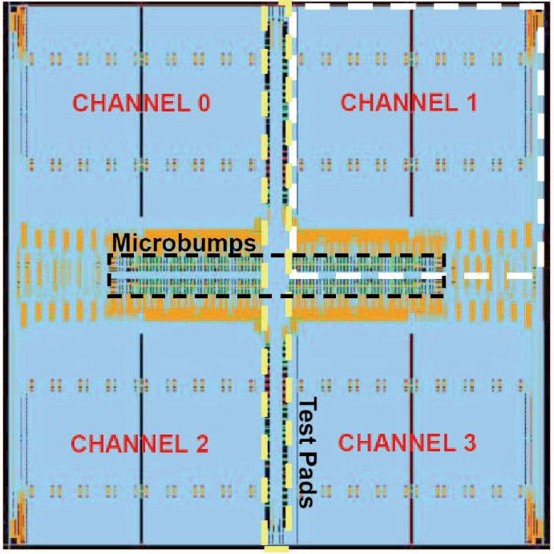
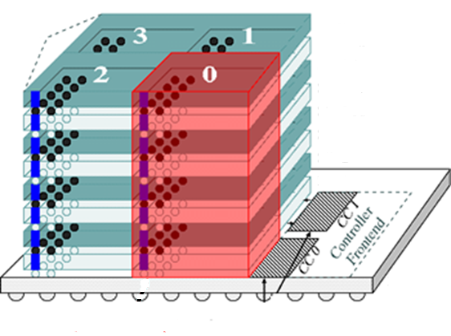
3D MPSoCs with Stacked DRAMs
3D Integration
Samsung Wide-I/O DRAM
Pros
One Die (Top View)
Cons
Higher Bandwidth
Difficult to manufacture
DRAM channels
Lower Energy
Thermal issues
…
…
DRAM dies
Core die
1 DRAM channel:
Spans 4 silicon dies & contains 8 banks (2 banks/die).
Data bus width: 128 Bits
Max clock : 200/300 MHz

Slide 13
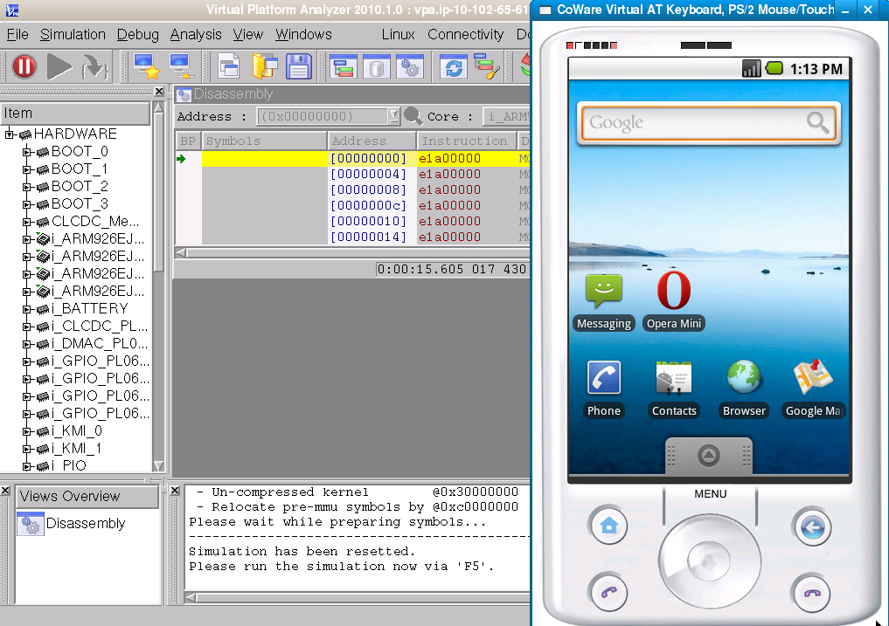
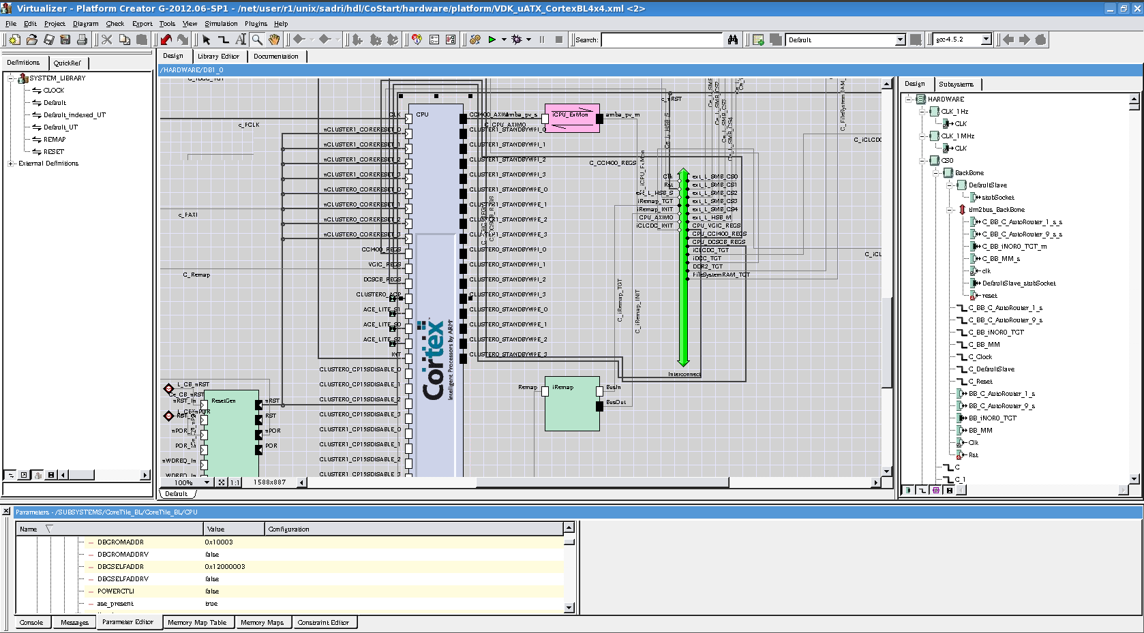
Transaction Level Modeling
The need for modeling more complex hardware: (RTL too slow!)
Running Android on TLM the platform
Example : Synopsys Platform Studio
Design Space
Exploration
Concurrent
HW/SW
Development
Transaction Level Models (TLM) :
Fast models for hardware components
Speed/Accuracy balance :
  Loosely Timed (LT)
  Approximately Timed (AT)
  Cycle Accurate (CA)
Sophisticated Design Debugging & Analysis
Early Power/
Performance
Analysis

Slide 14
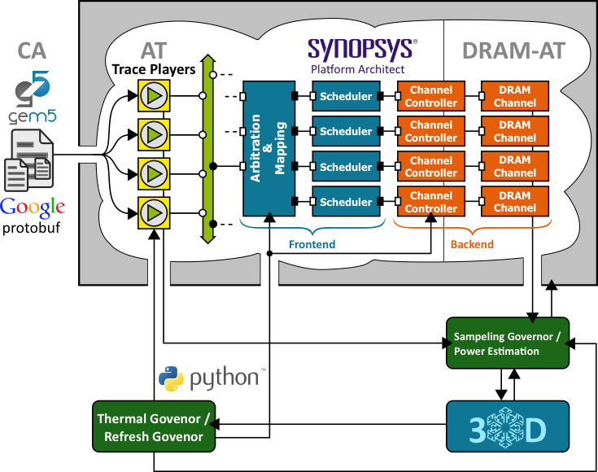
TLM Virtual Infrastructure
TLM Environment
gem5 simulates a multi-core ARM system.
Android OS with real-world benchmarks.
DRAM accesses trace captured
  Timing annotations
  Performance metrics of CPUs
Re-play the recorded trace:
  timings adjusted
CPU TLM models of Synopsys are Loosely Timed and not accurate!
Cycle Accurate TLM Models for CPUs (e.g. Carbon) are expensive!
gem5 used to model CPU operation.
Power Models
& Governors
(In Python)
3D-ICE
Thermal Model

Slide 15
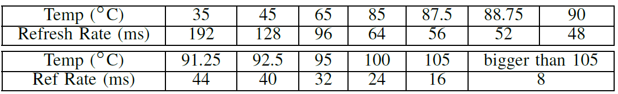
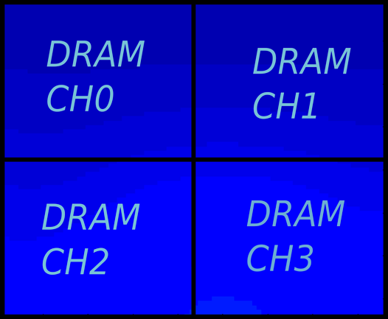
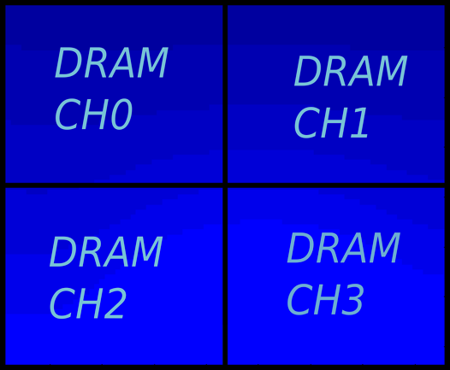

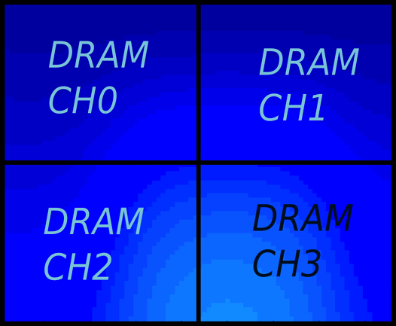
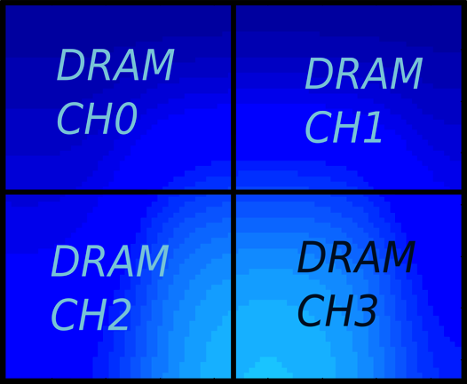
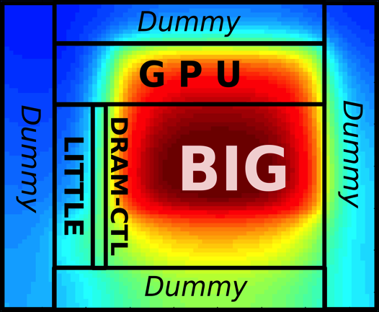
Temperature Variation Aware Bank-wise Refresh
Required refresh rate vs. Temperature (32MBits Bank)
Different refresh rates
for each of the DRAM banks
according to its own temperature!
An Idea!
Vertical variation in temperature of 2 banks of one DRAM channel in 2 different dies (5.6 C).
Lateral difference (variation) in temperature of 2 adjacent banks of one DRAM channel (3.3 C).
Sample thermal profile of the 3D chip

Slide 16
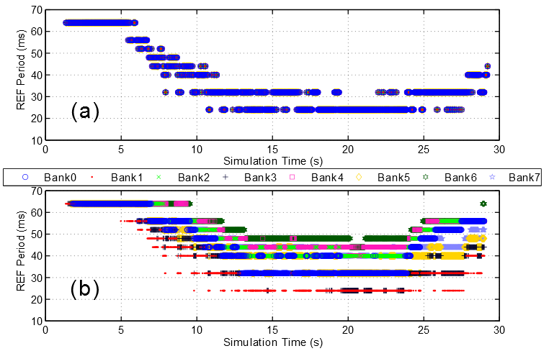
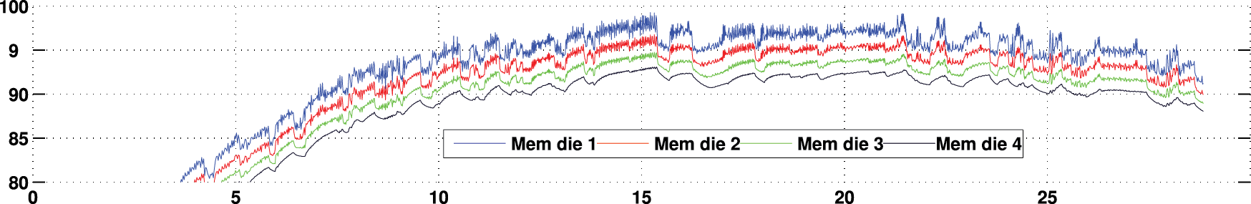
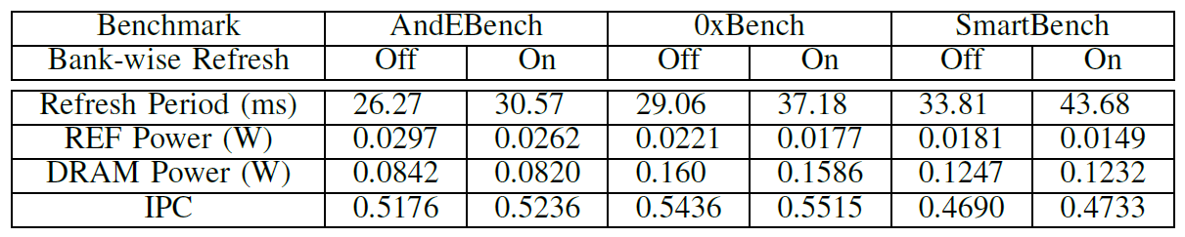
Temperature Variation Aware Bank-wise Refresh
Improvement in refresh rate : 24%
Improvement in averaged refresh power : 16%
5
Further description : [DATE14] , [DAC14]

Slide 17
Part IV
A Heterogeneous Architecture for
Temperature Variation Aware
Hardware Acceleration Research

Slide 18
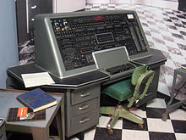
Hardware Acceleration : Motivations
1951
UNIVAC I : 0.015 operations per 1 watt-second
Half a century later!
2012
ST P2012 : 40 billion operations per 1 watt-second
Performance Per Watt!!
Problem : Perform More Computations with Less Energy!
Solution : Specialized functional units (Accelerators)

Slide 19
Hardware Acceleration : Issues
Better Performance Per Watt!
var1
DRAM
var2
var3
Accelerator
(specialized hardware)
cached
?????
How is the
address passed
to accelerator?
CPU
var1
What about Variables?
TASK 1
PHYSICAL
Accelerator
(specialized hardware)
VIRTUAL
TASK 2
MMU
L1$
var2
TASK 3
?????
TASK 4
Faster!
Shouldn’t CPU
Flush the cache!
Case 2
Case 1

Slide 20
Hardware Acceleration : Issues
Need …
A Real-World Platform to Perform Experiments!
var1
DRAM
var2
var3
Accelerator
(specialized hardware)
Accelerator
(specialized hardware)
cached
90 C
CPU
var1
TASK 1
Accelerator
(specialized hardware)
60 C
Accelerator
(specialized hardware)
TASK 2
L1$
75 C
var2
TASK 3
TASK 4

Slide 21
Xilinx ZYNQ Architecture
PL
PS
SGP0
Peripherals (UART, USB, Network, SD, GPIO,…)
SGP1
AXI
Masters
DMA Controller (ARM PL330)
HP0
DRAM Controller
(Synopsys IntelliDDR MPMC)
HP1
Inter
Connect
(ARM
NIC-301)
HP2
L2
PL310
Snoop
L1
ARM A9
NEON MMU
HP3
AXI
Slaves
MGP0
L1
ARM A9
NEON
MMU
MGP1
OCM
AXI Master
ACP

Slide 22
Primary Performance Explorations
PL
PS
For each method,
What is the data transfer speed?
How much is the energy consumption?
Effect of background workload on performance?
Which method is better
to share data between
CPU and Accelerator?
HP0
DRAM Controller
Snoop
L1
ARM A9
NEON MMU
AXI Master
(Accelerator)
L2
PL310
L1
ARM A9
NEON
MMU
OCM
ACP

Slide 23
Speed Comparison
ACP Loses!
CPU OCM between
CPU ACP & CPU HP
298MBytes/s
239MBytes/s
4K
16K
64K
128K
256K
1MBytes

Slide 24
Energy Comparison
CPU only methods : worst case!
CPU OCM always between
CPU ACP and CPU HP
CPU ACP ; always better energy than CPU HP0
When the image size grows CPU ACP converges CPU HP0

Slide 25
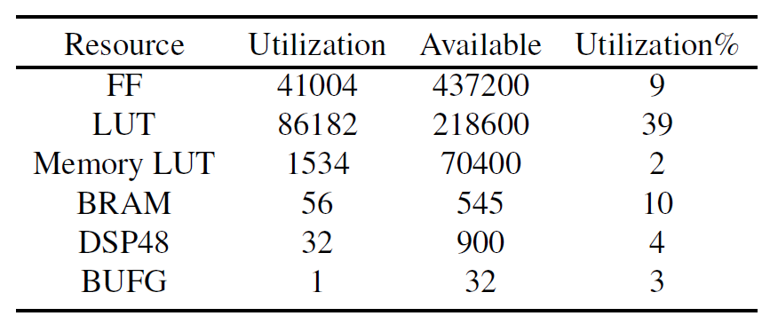
Heterogeneous Hardware Architecture
A heterogeneous architecture:
ARM host
Computational clusters:
  OpenRISC CPU cores
  Hardware accelerators
Cluster 0
OR1K
OR1K
Resource Utilization - 8 OpenRISC Cores – XC7045 (ZC-706 Board)
OR1K
OR1K
ARM
Host
Cluster 1
OR1K
OR1K
OR1K
OR1K
Cluster 2
OR1K
HW ACC
HW ACC
HW ACC
ZYNQ
PL
PS

Slide 26
Part V
Conclusions & Future Work

Slide 27
Conclusions
A thermal model for Intel SCC.
  Comparison with calibrated sensor readings.
Effect of on-die temperature variation on power/delay of circuits.
  MiMAPT evaluates designs considering temperature variation.
  MiMAPT significantly faster than traditional methods.
TLM platform for thermal/performance exploration of 3D MPSoCs.
  Temperature variation aware bank-wise refresh improves power.
Developed a complete heterogeneous hardware platform
  Enables future research regarding temperature variation aware control policies.
-

Slide 28
Outputs!
1
SCC Thermal Calibration Software
2
MiMAPT Tool
3
3D DRAM
Modeling TLM Platform
4
OpenRISC Cluster
For Xilinx ZYNQ

Slide 29
Ideas for Future Work
MiMAPT
  3D MiMAPT
  Evaluation of design containing blocks of memories
  Considering new fabrication technologies
TLM Platform
  Development of efficient thermal management policies (MPC)
  Extension of modeling capabilities to other variants of 3D logic.
  Integration of gem5 core into the TLM platform.
Heterogeneous Cluster
  Exploration of temperature variation aware hardware reconfiguration ideas
  Architectural enhancements

Slide 30
Publications
[VLSI INTEGRATION] | Mohammadsadegh Sadri, Andrea Bartolini, and Luca Benini. SUBMITTED: temperature variation aware multi-scale delay, power and thermal analysis at rt and gate level.
[THERMINIC11] | MohammadSadegh Sadri, Andrea Bartolini, and Luca Benini. Single-chip cloud computer thermal model.
[THERMINIC12] | Mohammadsadegh Sadri, Andrea Bartolini, and Luca Benini. Mimapt: Adaptive multi-resolution thermal analysis at rt and gate level.
[DATE14] | Mohammadsadegh Sadri, Matthias Jung, ChristianWeis, NorbertWehn, and Luca Benini. Energy optimization in 3d mpsocs with wide-i/o dram using temperature variation aware bank-wise refresh.
[FPGAWORLD13] | Mohammadsadegh Sadri, Christian Weis, Norbert Wehn, and Luca Benini. Energy and performance exploration of accelerator coherency port using Xilinx ZYNQ.
[DAC14] | Matthias Jung, Christian Weis, Mohammadsadegh Sadri, Norbert Wehn, and Luca Benini. SUBMITTED: optimized active and power-down mode refresh control in 3d-drams.
[PATMOS11] | Andrea Bartolini, MohammadSadegh Sadri, Francesco Beneventi, and others. A system level approach to multi-core thermal sensors calibration.
[DATE12] | Andrea Bartolini, Mohammadsadegh Sadri, J. Furst, A.K. Coskun, and L. Benini. Quantifying the impact of frequency scaling on the energy efficiency of the singlechip cloud computer.

Slide 31
Temperature Variation Aware Energy Optimization in Heterogeneous MPSoCs
Mohammadsadegh Sadri
Department of Electrical, Electronic and Information Engineering (DEI) University of Bologna, Italy
Supervisor : Prof. Luca Benini
{mohammadsadegh.sadr2,luca.benini}@unibo.it
Ver3-last update 28-jan-2014
Notes:
31
31

