Slide 1
Energy and Performance Exploration of Accelerator Coherency Port Using Xilinx ZYNQ
Mohammadsadegh Sadri, Christian Weis, Norbert When and Luca Benini
Department of Electrical, Electronic and Information Engineering (DEI) University of Bologna, Italy
Microelectronic Systems Design Research Group, University of Kaiserslautern, Germany
{mohammadsadegh.sadr2,luca.benini}@unibo.it, {weis,wehn}@eit.uni-kl.de
ver0
Notes:
1
1

Slide 2
Outline
Introduction
ZYNQ Architecture (Brief)
Motivations & Contributions
Infrastructure Setup (Hardware & Software)
Memory Sharing Methods
Experimental Results
Lessons Learned & Conclusion

Slide 3
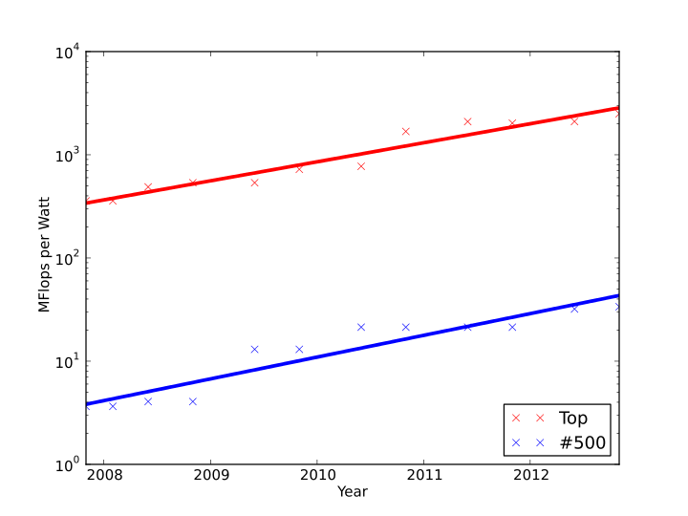
Introduction
Performance Per Watt!!
1951
UNIVAC I : 0.015 operations per 1 watt-second
Half a century later!
2012
ST P2012 : 40 billion operations per 1 watt-second

Slide 4
Introduction
Solution : Specialized functional units (Accelerators)
- Problem can be more complicated!
e.g. Multiple CPU cores!
- Every processing element:
Should have a consistent view of the shared memory!
- Accelerator Coherency Port (ACP):
Allows accelerator hardware
To Perform coherent accesses
To CPU(s) memory space!
Better Performance Per Watt!
var1
DRAM
var2
var3
Accelerator
(specialized hardware)
cached
CPU
var1
What about Variables?
TASK 1
Accelerator
(specialized hardware)
TASK 2
L1$
var2
TASK 3
?????
TASK 4
CPU should
Flush the cache!
Faster!
More Power Efficient!
Case 2
Case 1

Slide 5
Xilinx ZYNQ Architecture
PL
PS
SGP0
Peripherals (UART, USB, Network, SD, GPIO,…)
SGP1
AXI
Masters
DMA Controller (ARM PL330)
HP0
DRAM Controller
(Synopsys IntelliDDR MPMC)
HP1
Inter
Connect
(ARM
NIC-301)
HP2
L2
PL310
Snoop
L1
ARM A9
NEON MMU
HP3
AXI
Slaves
MGP0
L1
ARM A9
NEON
MMU
MGP1
OCM
AXI Master
ACP

Slide 6
Motivations & Contributions
PL
PS
For each method,
What is the data transfer speed?
How much is the energy consumption?
Effect of background workload on performance?
Which method is better
to share data between
CPU and Accelerator?
Various acceleration methods are addressed in the
literature (GPU, hardware boards, …)
We develop an infrastructure (HW+SW)
For the Xilinx ZYNQ
We run practical tests & measurements
To quantify the efficiency of different CPU-accelerator
memory sharing methods.
HP0
DRAM Controller
Snoop
L1
ARM A9
NEON MMU
AXI Master
(Accelerator)
L2
PL310
L1
ARM A9
NEON
MMU
OCM
ACP

Slide 7
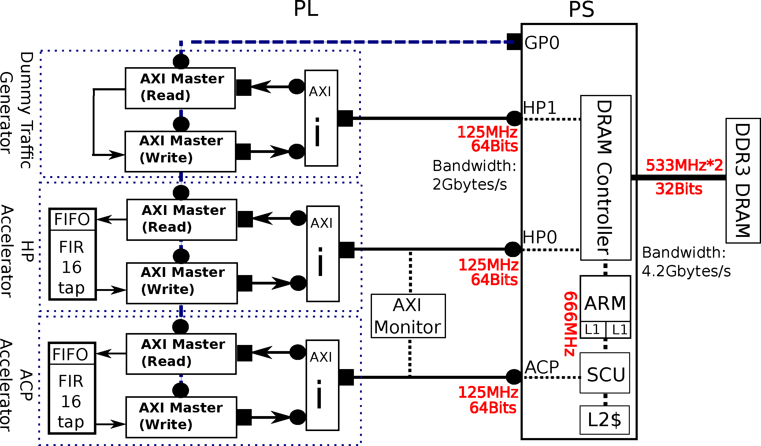
Hardware

Slide 8
Software
Linux Kernel Level
Drivers
AXI Driver user side interface application
Background application:
A Simple memory read/write loop
AXI Dummy
Driver
AXI Driver
More complicated:
Handles AXI masters
ACP & HP0
Memory allocation
ISR registration
statistics PL310
time measurement
Simple driver:
Initializes the dummy AXI masters (HP1)
Triggers an endless read/write loop
Oprofile statistical profiler.
Measure all CPU performance metrics.
Over ACP: kmalloc
Over HP: dma_alloc_coherent

Slide 9
Processing Task Definition
We define : Different methods to accomplish the task.
Measure : Execution time & Energy.
Allocated by:
kmalloc
dma_alloc_coherent
Depends on the memory
Sharing method
Source Image
(image_size bytes)
@Source Address
Selection of Pakcets:
(Addressing)
- Normal
- Bit-reversed
Result Image
(image_size bytes)
@Dest Address
128K
Loop: N times
Measure execution interval.
Image Sizes:
4KBytes
16K
65K
128K
256K
1MBytes
2MBytes
FIFO: 128K
FIR
read
write
process

Slide 10
Memory Sharing Methods
ACP Only (HP only is similar, there is no SCU and L2)
Accelerator
SCU
L2
DRAM
ACP
CPU only (with&without cache)
CPU
CPU ACP
(CPU HP similar)
2
1
Accelerator
SCU
L2
DRAM
ACP
ACP ---
CPU ---
ACP ---

Slide 11
Speed Comparison
ACP Loses!
CPU OCM between
CPU ACP & CPU HP
298MBytes/s
239MBytes/s
4K
16K
64K
128K
256K
1MBytes

Slide 12
Dummy Traffic Effect
ACP: 1664Mbytes/s
HP: 1382Mbytes/s
CPU dummy traffic
Occupies cache entries
So less free entries remain
for the accelerator
256K

Slide 13
Power Comparison

Slide 14
Energy Comparison
CPU only methods : worst case!
CPU OCM always between
CPU ACP and CPU HP
CPU ACP ; always better energy than CPU HP0
When the image size grows CPU ACP converges CPU HP0

Slide 15
Lessons Learned & Conclusion
If a specific task should be done by the cooperation of
CPU and accelerator:
CPU ACP and CPU OCM are always
better than CPU HP in terms of energy
If we are running other applications which
heavily depend on caches, CPU OCM and then CPU HP are preferred!
If a specific task should be done by accelerator only:
For small arrays ACP Only & OCM Only can be used
For large arrays (>size of L2$) HP Only always acts better.

