Slide 1



[MULTITHERMAN]
MiMAPT: Adaptive Multi-Resolution Thermal Analysis at RT and Gate Level
Mohammadsadegh Sadri, Andrea Bartolini, Luca Benini
Micrel Lab – Electronics and Information Department
University of Bologna
ver2
Notes:
1
1

Slide 2
Outline
Introduction
Motivations
Basic description of MiMAPT
What is new in MiMAPT?
Architecture of MiMAPT
Experimental Results
Conclusion

Slide 3
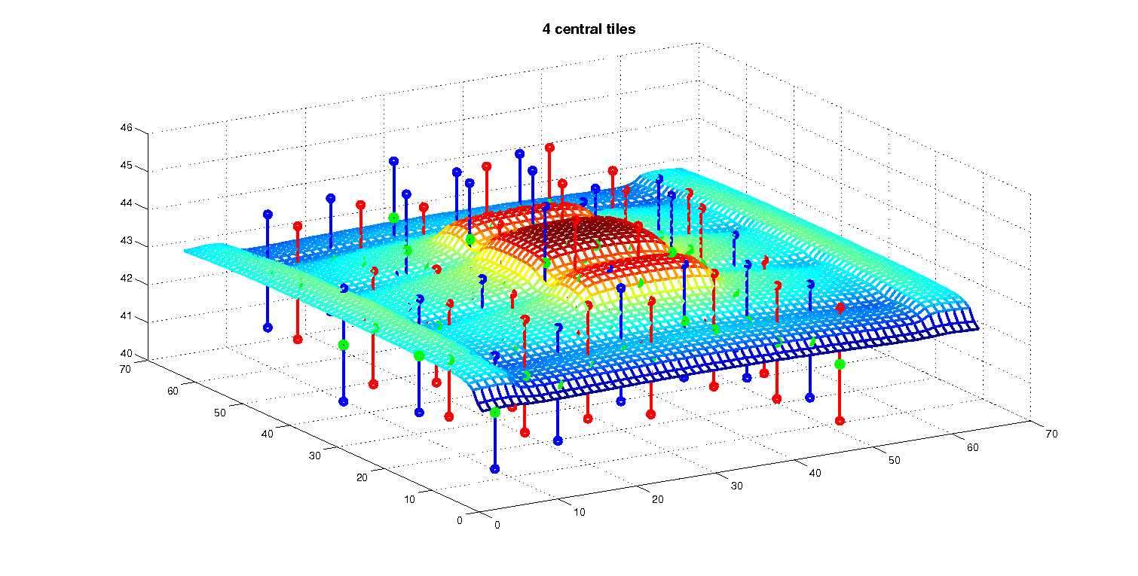
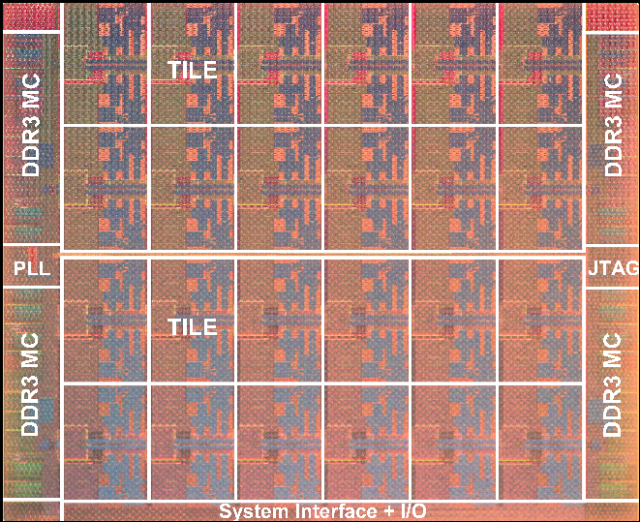
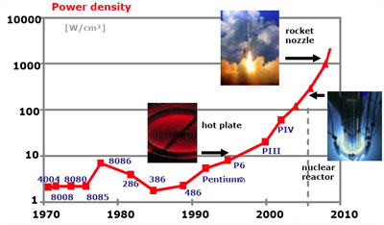
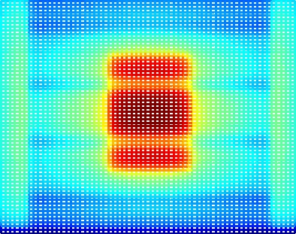
Introduction
Magnificant
temperature
gradient!
At higher power
densities, can
easily turn
into hotspot!
MPSoCs, Many-cores,…
Increasing power density!
Hotspots!
Hotspots!
  Failure! Accelerated aging! …
  Example:
    THERMINIC11
    (Intel SCC Thermal Model)

Slide 4
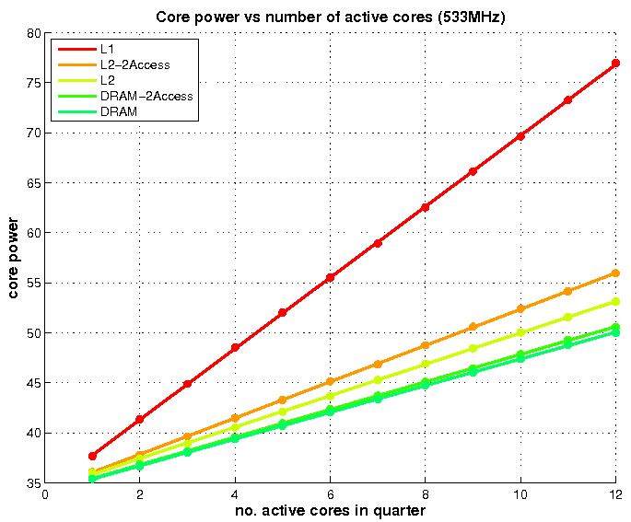
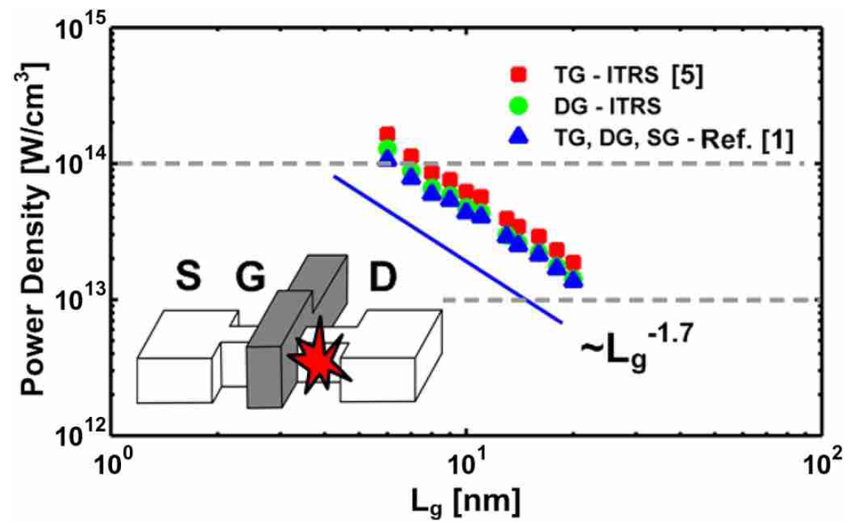


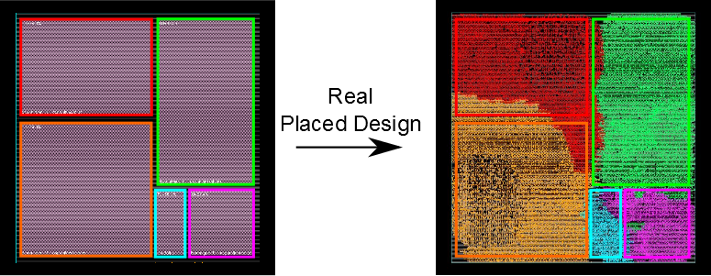


Motivations
Need for a Short-cut!
  Early detection of suspicious cases
  Trigger Fine-grain only when needed!
High Power
Densities
Temporal Variability of workload
Non-regular layouts for RTL entities
Academic Packages?
Open source
Suitable for Research
Detailed spatial resolution for thermal simulation
Transient thermal simulation over long intervals
Build a versatile method to define thermal floorplan
For nowadays designs:
Very time consuming!
Practically Impossible!
Thermal floorplan, different than layout floorplan!

Slide 5


MiMAPT
Micrel’s Multi-scale Analyzer for Power and Temperature
Cadence Flow:
  RTL Compiler (RC) (v.10.1)
  SoC Encounter (v.10.1)
Synopsys Flow:
  Design Compiler (v2010.03)
  ICC Compiler (v2010.03)
  PrimeTime (v2010.06)
1
MiMAPT Understands:
Standard design flow file formats:
  .LIB, .LEF : Std-cell Lib.
  .DEF, .TCL: physical info
  ...
Tool report formats:
  Synthesizer power report
  Timing/Power analysis tool power/delay reports
2
3
Fast & Accurate
Detection of Hotspots
(Spatial and Temporal coordinates)
MiMAPT integrates into Standard ASIC design flow
MiMAPT is not limited to a specific thermal simulation engine
(currently uses Hotspot)
Acceleration:
Do thermal simulation at RT Level
Switch to Gate Level when necessary
Not in this paper!

Slide 6
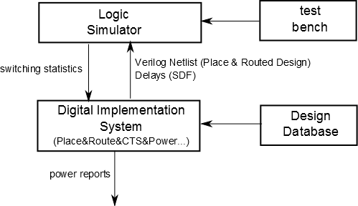
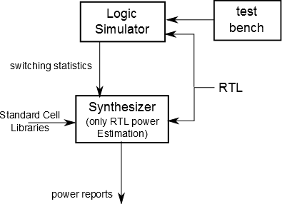
Important Basics: Power Estimation
At gate level:
At RTL: Recent synthesis engines
Run time ~ 900s
Run time ~ 70s
Generic
RTL
Gate Level
RT Level
Better Accuracy

Slide 7
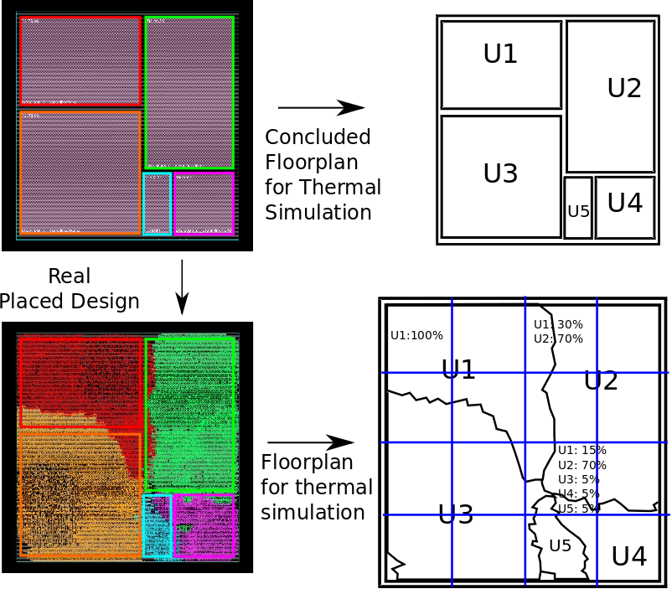
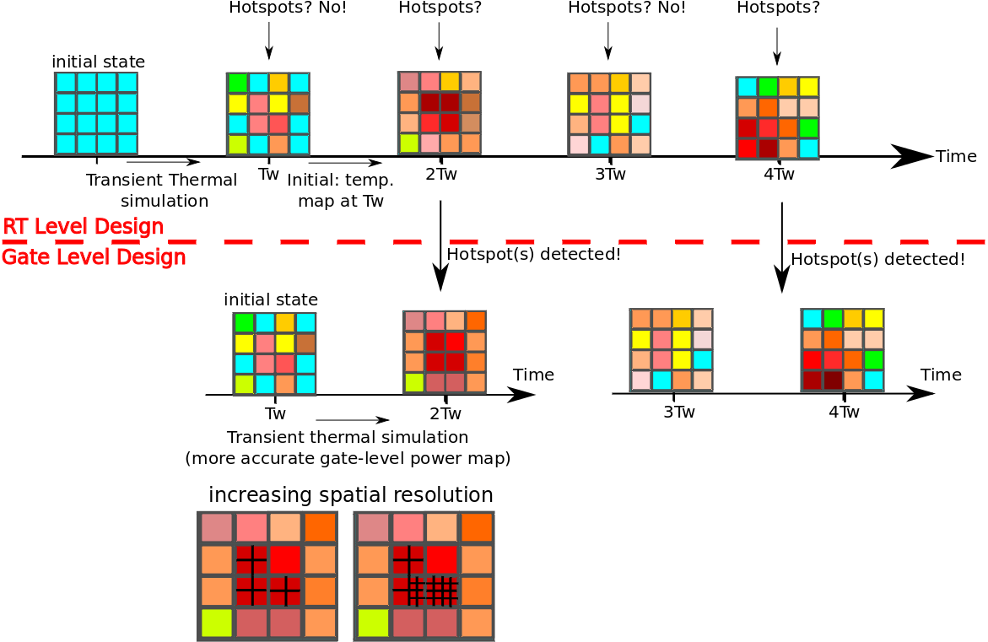
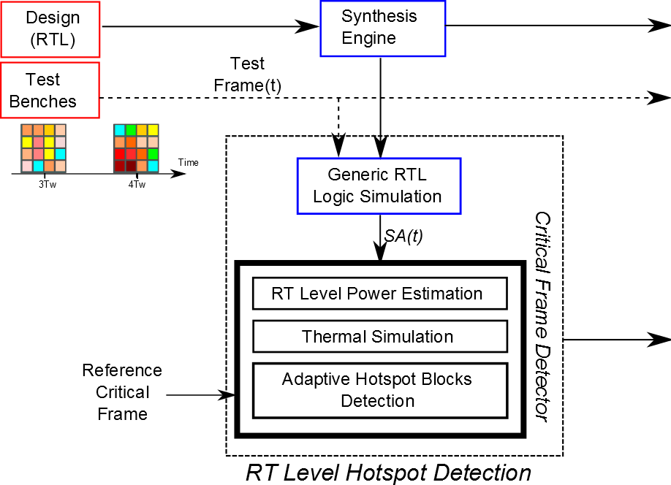
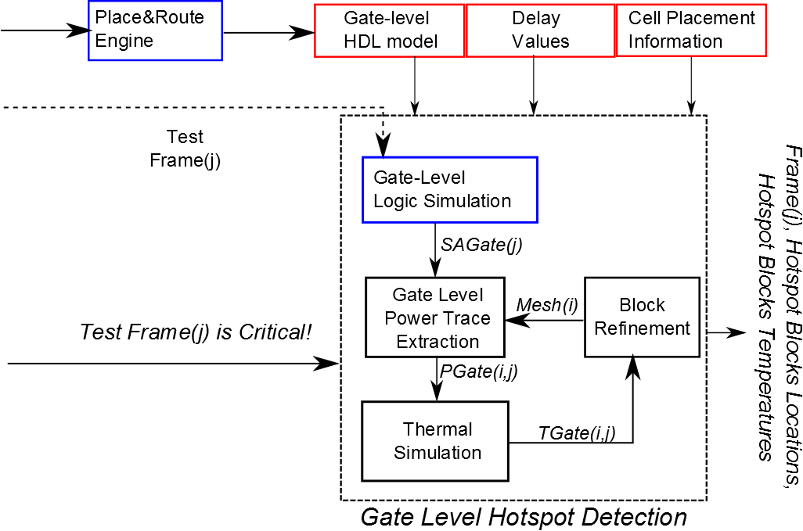
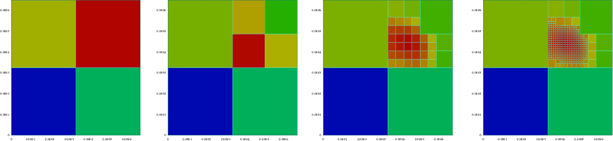
General Architecture
RT Level
Gate Level
Increase spatial resolution only for blocks with T>TH

Slide 8
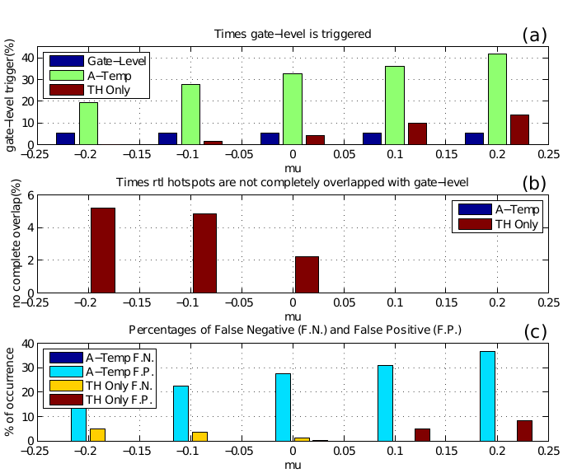
Hotspot Detection at RTL
Estimated power at RTL:
  not equal to gate-level
Unique threshold to identify Hotspots:
  Not accurate
Adaptive method hotspot detection at RTL:
  Threshold based on the results of gate level simulation for highest power test frame
Evaluation of method:
  Create 180 semi-virtual (RTL, gate level) power pairs, test the algorithm

Slide 9
Sample Test Chip
Contains 3 widely used modules
  AES, FPU and FFT
TSMC 65LP standard cell library
  Synthesis , Placement, CTS and Routing
Block | Area(mm2) | #Cells | FFs | Clk Buf | F(MHz)
FPU | 0.2730 | 41477 | 499 | 13 | 143
FFT | 0.6997 | 81651 | 42684 | 875 | 525
AES | 0.4758 | 110758 | 7882 | 167 | 1328
Top | 1.49 | 233887 | 51065 | 1055 | -

Slide 10
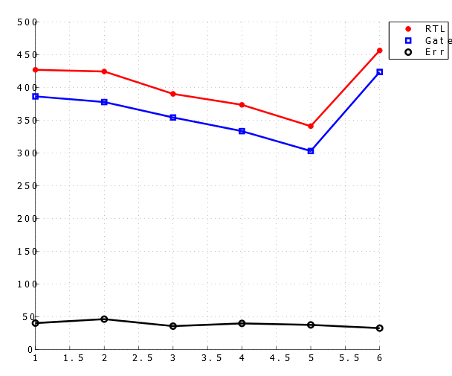
Test Case
Six test frames
  Each test frame
    Different running clock per module
    Different work load applied to module
Test frame duration: 0.2s
  During of each transient thermal simulation
Optimization, Power/Delay Calculation
  Typical corner case: T=25C , VDD=1.2v.
Total power

Slide 11
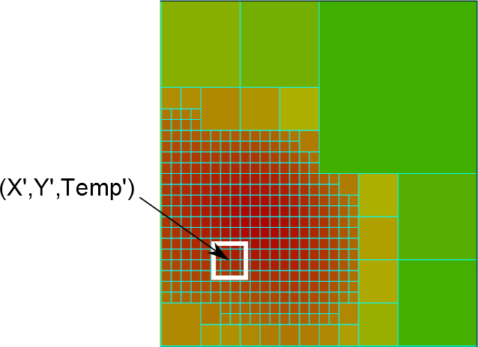
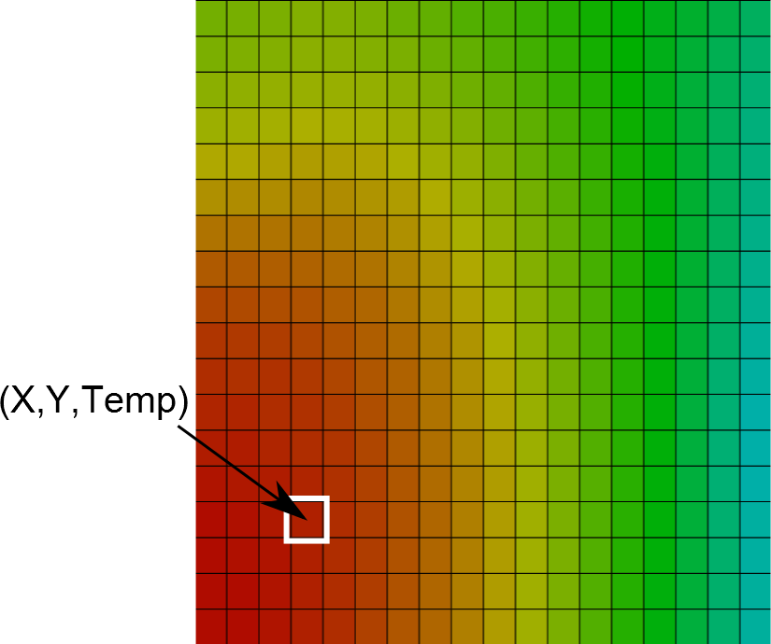
MiMAPT vs. Fine-Grain
Method | RTL Logic Sim | RTL Thermal Sim | Gate-Level Logic sim | Gate-Level Thermal | Total
Fine-grain | - | - | 1610 | 24910 | 26520
MiMAPT | 83 | 72 | 908 | 359 | 1446
Design
&
Test case
Temperature difference for Hotspots estimated by MiMAPT vs. fine grain: 0.02K.
Spatial distance between Hotspot detected by MiMAPT vs. Fine-grain is ~ 0.0um.
Processed Test Frames:
3 Only at RTL!
3 at RTL and Gate-level
2 False Positives
Processed Test Frames:
6 at Gate-level
Execution Time:
1446s
Execution Time:
26520s
Init Floorplan:
Grid of 8X8
(64 Blocks)
MiMAPT
Fine-Grain
Fixed Floorplan:
Grid of 24X24
(576 Blocks)
Execution Time
Hotspots:
  Spatial/Temporal Coordinates
  Temperature

Slide 12
MiMAPT Speed-up (Generic Test Frame)
Best case: All frames non-critical
  Gate level never triggers
Worst case: All frames critical
Test Frame Type | MiMAPT Time RTL | MiMAPT Time Gate | Example Speed-up
Non-critical | Rsim + Rthr | - | 171X
False Positive | Rsim + Rthr | Gsim + GthrL1 | 13X
Critical | Rsim + Rthr | Gsim + GthrL1 + GthrL2 | 7X
Rsim : RTL Logic simulation – Rthr: RTL thermal simulation – Gsim: Gate level logic simulation –
GthrL1: Coarse-grained thermal simulation at Gate level –
GthrL2: time for higher resolution thermal simulation at gate level (in which splitting has
Happened for hotspot blocks)

Slide 13
Sample Ideas for Future Work
Expanding the borders:
  To higher levels of design:
    Architecture - RTL - Gate!
  To lower levels of design:
    RTL – Gate – Transistors
    Boltzmann Transport Equations (Higher Accuracy)`
Architecture
Using more accurate thermal simulation engines
Multi-scale, temperature variation aware thermal/power/delay estimation
…
New Constraints
Initial Constraints
RTL
(Generic)
Synthesis
Current MiMAPT
Cells (Gates)
Automatic generation of guiding constraints for Synthsis and Place&Route tools based on obtained temperature maps
MiMAPT
Place & Route
Transistors
(MOSFET)

Slide 14
Conclusion
MiMAPT :
  Speed-up:
    For our example chip: 7X - 170X
  Accuracy:
    Exact spatial location as fine-grain, less than 0.02 degrees difference in temperature
MiMAPT relies on:
  A thermal simulator (like Hotspot)
    Different accuracy of chip/package modeling
  Synthesis tool for power estimation at RTL
    Not mature! (is improving…)
    Used adaptive method as a solution.

